Slide 1
End of Chemistry Revision Year 9 Science

Slide 2
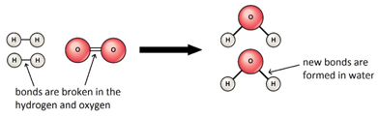
Concept Development
Breaking Bonds
All substances contain chemical energy, stored in the bonds between the atoms.
The bonds between the atoms are broken during a chemical reaction and reformed when the new substance is created.

Slide 3
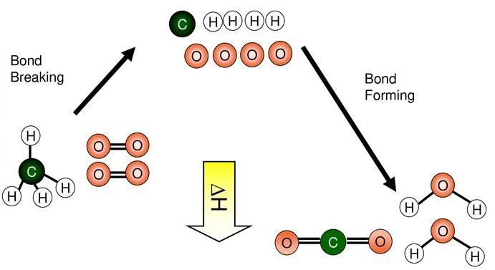
Concept Development
Breaking Bonds
When methane reacts with oxygen, the bonds in the methane and the bonds in the oxygen molecules are broken.
The atoms are rearranged to form water and carbon dioxide, forming new bonds.

Slide 4

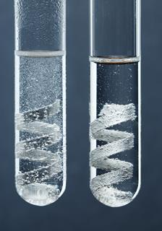
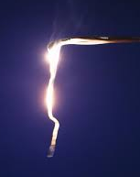
Concept Development
Exothermic Reactions
Reactions that release energy are called exothermic reactions.
The word exothermic is derived from
‘exo’ meaning external or outside and
‘thermic’ meaning heat
The energy released is usually heat energy, but can also be other forms including light and electrical.
Examples of exothermic reactions are:
Lighting a match
Hydrochloric acid reacting with magnesium
Magnesium reacting with oxygen

Slide 5
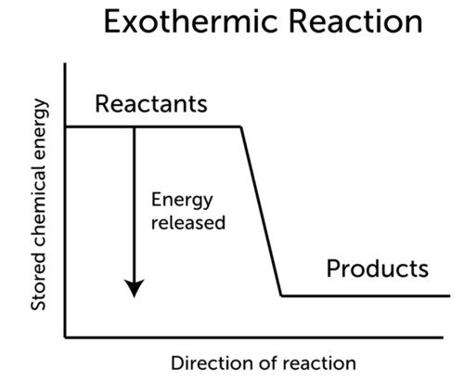
Concept Development
Exothermic Reactions
Reactions that release energy are called exothermic reactions.
The energy produced by breaking bonds in the reactants is more than what is needed to form the products.
This means there is unused energy, which we observe as heat and/or light.

Slide 6

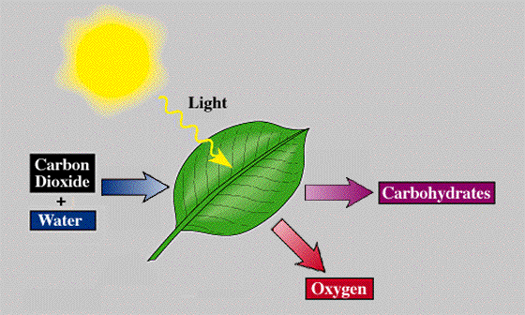
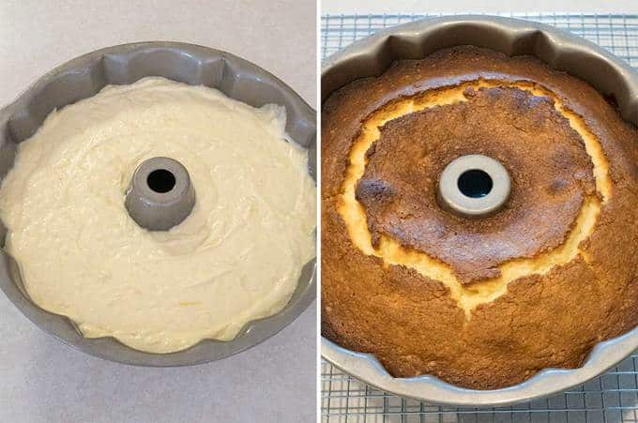
Concept Development
Endothermic Reactions
Reactions that absorb energy are called endothermic reactions.
The word endothermic is derived from
‘endo’ meaning internal or within and
‘thermic’ meaning heat
Endothermic reactions absorb heat from the surroundings and so feel cold, or need continuous heating.
Examples of endothermic reactions are:
In photosynthesis, plants absorb light to make food
Instant cold packs
Baking a cake

Slide 7
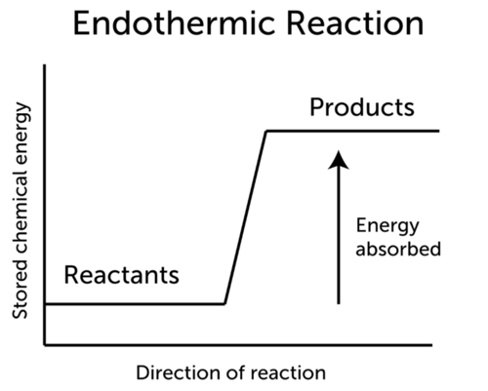
Concept Development
Endothermic Reactions
Reactions that absorb energy are called endothermic reactions.
The energy produced by breaking bonds in the reactants is not enough to form the products.
Extra energy is taken from the surroundings to make the products.

Slide 8
Concept Development
Representing Exothermic and endothermic Reactions
The change in energy during a reaction can be shown in word equations by writing whether energy is absorbed or released above the arrow.
Energy is not a reactant or a product, so is not included on the reactants or products side of the equation.
Reactants
Nitric acid + Zinc
Energy
released
Products
Zinc nitrate+ Hydrogen

Slide 9
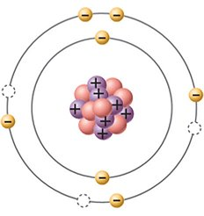
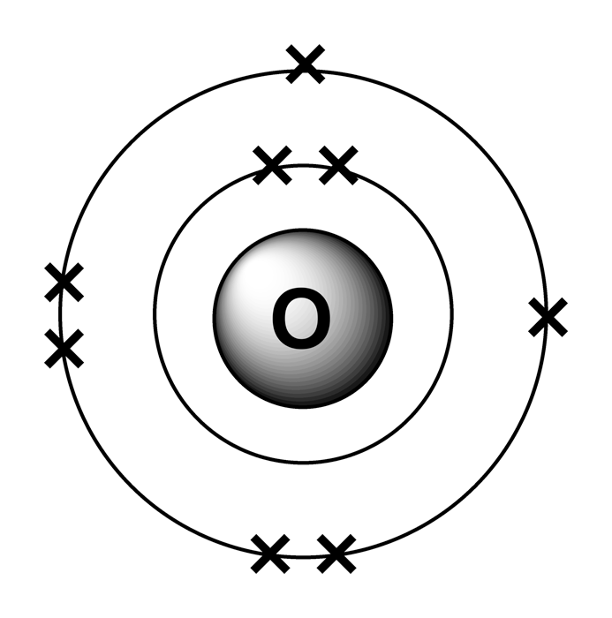
Concept Development
N³⁻
Ions
Ions form when atoms gain or lose electrons, becoming charged.
Atoms gain or lose electrons to obtain a full outer (valence) shell – the same as the nearest noble gas (group 18)
The nitrogen atom gains 3 electrons to fill the valence shell.
It gains three negative charges forming a nitride ion with a charge of 3-.
The charge of an ion is written at the top right of the symbol.
The charge on an ion is also called its valency.

Slide 10
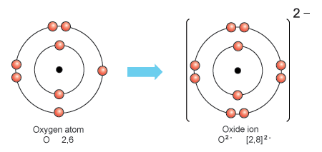
Concept Development
Negative Ions
Formed when atoms gain electrons to fill the valence shell to the nearest noble gas configuration.
The number of electrons the atom gains becomes the negative charge on the ion.
Oxide ions form when an oxygen atom gains 2 electrons.
Fluoride ions form when a fluorine atom gains 1 electron.
O²⁻
F⁻

Slide 11
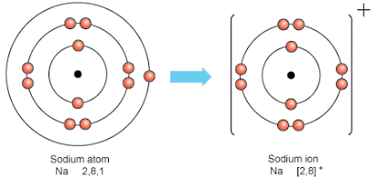
Concept Development
Positive Ions
Formed when atoms lose electrons to empty the valence shell to the nearest noble gas configuration.
The number of electrons the atom loses becomes the positive charge on the ion.
Sodium ions form when a sodium atom loses 1 electron.
Calcium ions form when a calcium atom loses 2 electrons.
Na⁺
Ca²⁺

Slide 12
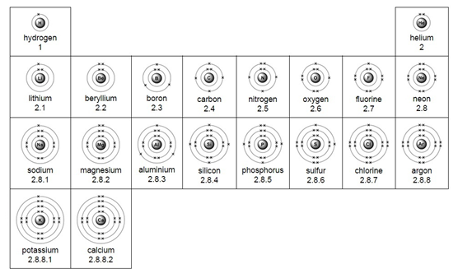
Concept Development
Using the Periodic Table to Predict Valencies
Elements in group 1 always lose their valence electron, forming ions with a valency of 1+ H⁺ Li⁺ Na⁺ K⁺
Elements in group 2 always lose 2 valence electrons, forming ions with a valency of 2+ Be²⁺ Mg²⁺ Ca²⁺
Group 1
Group 2

Slide 13
Concept Development
Using the Periodic Table to Predict Valencies
Elements in group 17 always gain one valence electron to fill the valence shell, forming ions with a valency of -1 F⁻ Cℓ⁻ Br⁻
Elements in group 16 always gain 2 valence electrons to fill the valence shell, forming ions with a valency of -2 O²⁻ S²⁻ Se²⁻
Group 18
Group 16
Group 17

Slide 14
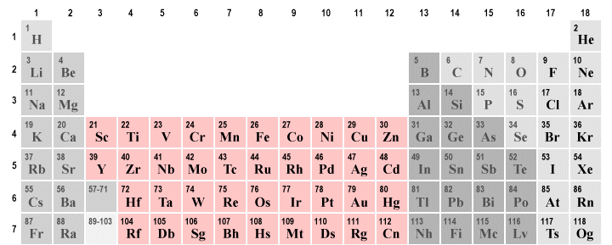
Concept Development
Elements with Multiple Valencies
Some transition metals can form ions with different valencies.
Lead can form ions with a valency of 2+ or 4+ Pb²⁺ or Pb⁴⁺
The valency is written as roman numerals in brackets after the name of the element Lead (II) or Lead (IV)

Slide 15
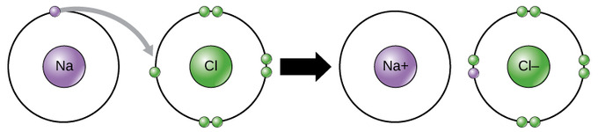
Concept Development
Ionic Compounds
Ionic compounds form when a metal with a nearly empty outer shell reacts with a non-metal with a nearly full outer shell.
The metal loses the electrons from the valance shell and donates them to the non-metal, filling its valence shell.
The oppositely charged ions attract, forming an ionic bond.

Slide 16
Concept Development
Rules for Writing Ionic Formulae
The positive ion is written first.
The negative ion is written second (non-metal or group of non-metals).
The total number of each ion is adjusted so that the total positive charge equals the total negative charge.
Subscripts are used to indicate the number of each ion present.
For example Calcium bromide
Ca²⁺ Br⁻
1 Ca²⁺ for 2 Br⁻
CaBr₂

Slide 17
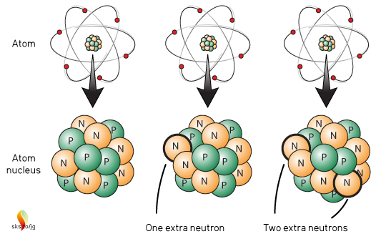
Concept Development
Isotopes
While the number of protons in the nucleus of atoms in an element stays the same, the number of neutrons can change.
Atoms of the same element, but with different numbers of neutrons are called isotopes.
For example, the carbon isotopes all have 6 protons, but have different numbers of neutrons.
Vocabulary
Subatomic: smaller than, or occurring within, an atom

Slide 18
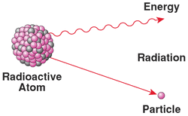
Concept Development
Radioisotopes
In some isotopes, when the ratio of neutrons to protons is too high, the nucleus is unstable.
These unstable isotopes decay or change into another isotope that is more stable.
When isotopes decay, they emit particles and radiation.
Isotopes that emit radiation are called radioisotopes.

Slide 19
Concept Development
Radioactive Half-Life
Radioactive decay is a random process, so we cannot predict exactly when a radioactive nucleus will decay.
As a radioactive sample decays, less and less of the original substance is left, so the radioactivity drops.
The half-life of a radioactive material, is the time taken for half of the radioactive nuclei in the sample to decay.
This is also when the radioactivity of the sample is reduced to half its original level.

Slide 20
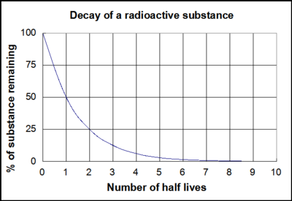
Concept Development
Radioactive Half-Life
When one half-life has passed, the radioactivity reaches half of its original level.
When two half-lives have passed, the radioactivity reached a quarter of its original level (half of a half).
After three half-lives, an eighth of the original level of radioactivity remains.

Slide 21
Concept Development
Radioactive Half-Life
Different radioisotopes have different half-lives.
Some half-lives are measured in minutes, some in days, and some in years.
Radioisotope | Half-Life
Bismuth-213 | 46 minutes
Technetium-99 | 6 hours
Lutetium-177 | 7 days
Iodine-131 | 8 days
Chromium-51 | 28 days
Carbon-14 | 5739 years

Slide 22
Concept Development
Nuclear Radiation
Nuclear radiation describes any rays or particles emitted (released) by atomic nuclei.
There are three types of nuclear radiation that can be emitted, which are:
Alpha radiation (α)
Beta radiation (β)
Gamma radiation (γ)
These types of radiation are called ionising radiation because they can remove electrons from atoms and molecules.
Exposing cells to ionising radiation can cause them to mutate or die.
Vocabulary
Nuclei: plural of nucleus

Slide 23
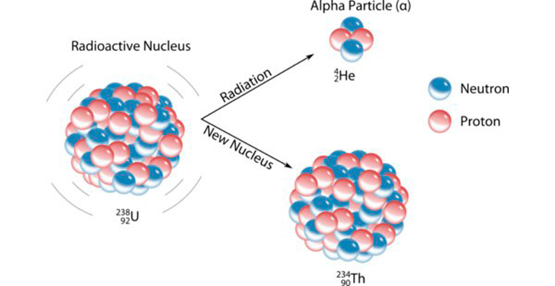
Concept Development
Alpha Radiation
During alpha decay, a nucleus emits an alpha particle.
An alpha particle is a group of two protons and 2 neutrons (the same as a helium nucleus)
Alpha decay occurs in very large nuclei, for example uranium-238 or radium-226.

Slide 24
Concept Development
Alpha Radiation
When an alpha particle is emitted, the number of protons drops by 2, so the atom becomes a different element.
For example, uranium has 92 protons, so when it emits an alpha particle it becomes thorium, with 90 protons.

Slide 25
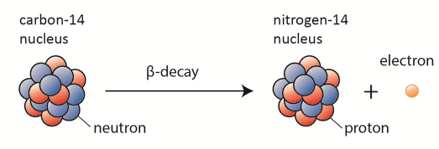
Concept Development
Beta Radiation
During beta decay, a nucleus emits a beta particle.
A beta particle is produced when a neutron in the nucleus decays into a proton and an electron.
The electron is the beta particle that leaves the atom.

Slide 26
Concept Development
Beta Radiation
When a beta particle is emitted, a neutron becomes a proton, so the atomic number increases by 1, and the atom becomes a new element.
For example, carbon has 6 protons, so when it emits a beta particle it becomes nitrogen, with 7 protons.

Slide 27
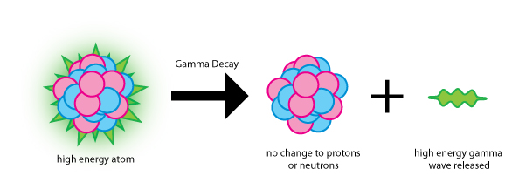
Concept Development
Gamma Radiation
During gamma decay, a nucleus emits gamma radiation.
Gamma rays are high-energy electromagnetic rays, similar to X-rays.
They can be emitted with alpha and beta particles, or when a nucleus rearranges itself.

Slide 28
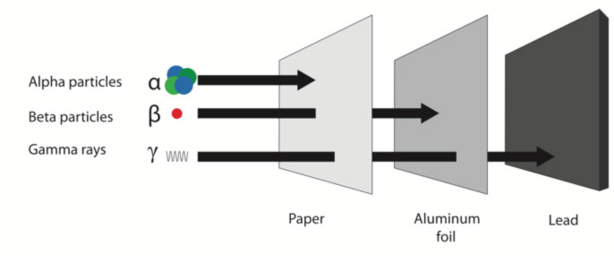
Concept Development
Properties of Alpha Radiation
Alpha particles are large and slow compared to other types of radiation.
Their large size means they collide with atoms often, causing more damage (they are the most ionising form of radiation)
Their large size also means that they can only travel a few centimetres in air, and can be stopped by paper.
Vocabulary
Ionising radiation: radiation with enough energy to remove electrons from substances

Slide 29
Concept Development
Properties of Beta Radiation
Beta particles are smaller and faster than alpha particles.
They collide with atoms often, causing some damage to cells.
As they are smaller than alpha particles, they are able to travel further through objects.
Beta particles can be stopped by a thin sheet of aluminium foil.
Vocabulary
Ionising radiation: radiation with enough energy to remove electrons from substances

Slide 30
Concept Development
Properties of Gamma Radiation
Gamma rays are a form of electromagnetic radiation, so they travel at the same speed as light.
This type of radiation can pass through most objects, only a thick layer of lead or concrete will stop gamma rays.
Vocabulary
Ionising radiation: radiation with enough energy to remove electrons from substances

Slide 31
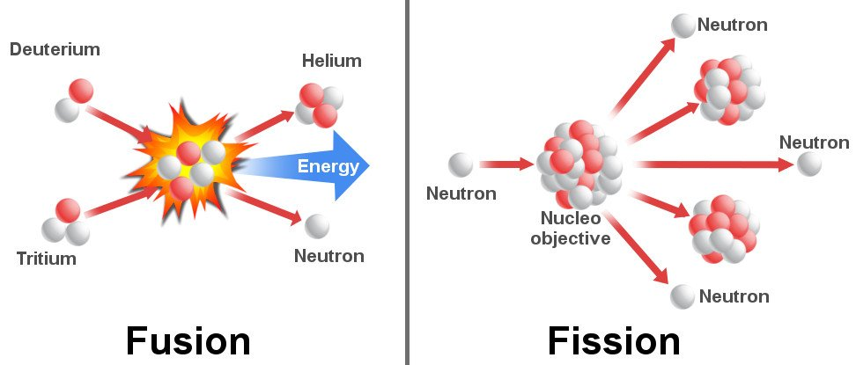
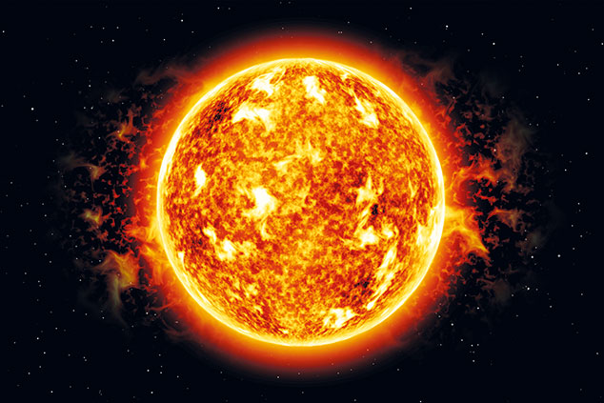
Concept Development
Vocabulary
Nuclei: plural of nucleus
Nuclear Fusion
Fusion reactions happen when two small nuclei fuse together.
When the atoms fuse, a large amount of energy is released.
For example, when deuterium (hydrogen-2) and tritium (hydrogen-3) fuse, they form a helium nucleus and a neutron, and release energy.
Nuclear fusion reactions occur naturally in stars.

Slide 32
Concept Development
Vocabulary
Nuclei: plural of nucleus
Nuclear Fusion
Fusion reactions have been used in hydrogen bombs and nuclear weapons.
Even though nuclear fusion reactions release a large amount of energy and no nuclear waste, they are not used to produce electricity.
This is because large amounts of heat are released from these reactions and we have not developed the technology to contain the reaction.

Slide 33
Concept Development
Nuclear Fission
During a fission reaction, a large unstable nucleus splits into two smaller ones.
A neutron is fired into the nucleus of the atom.
This causes the atom to split into two smaller atoms.
When the atom splits, a large amount of energy is released, as well as some neutrons.

Slide 34
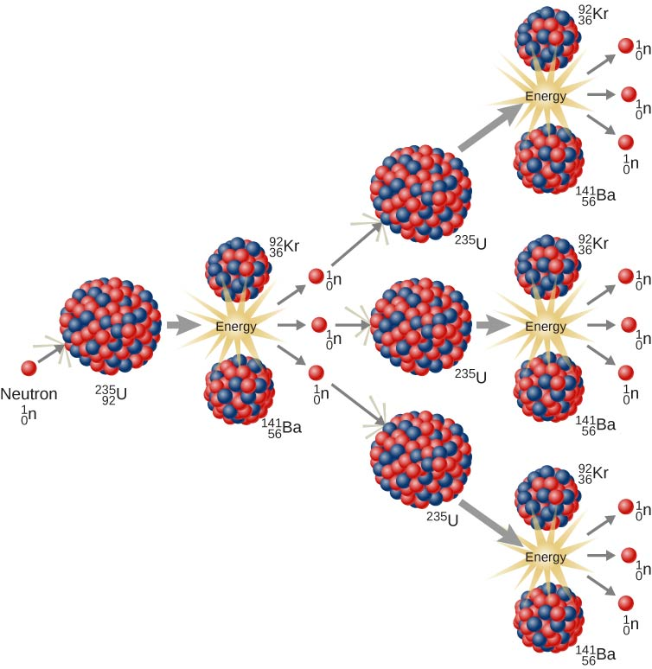
Concept Development
Nuclear Fission
For example, when Uranium-235 is hit by a neutron, it becomes Uranium-236, which is unstable.
It breaks apart into two smaller nuclei and some neutrons.
The neutrons can then collide with another Uranium-235, triggering a chain reaction.

Slide 35
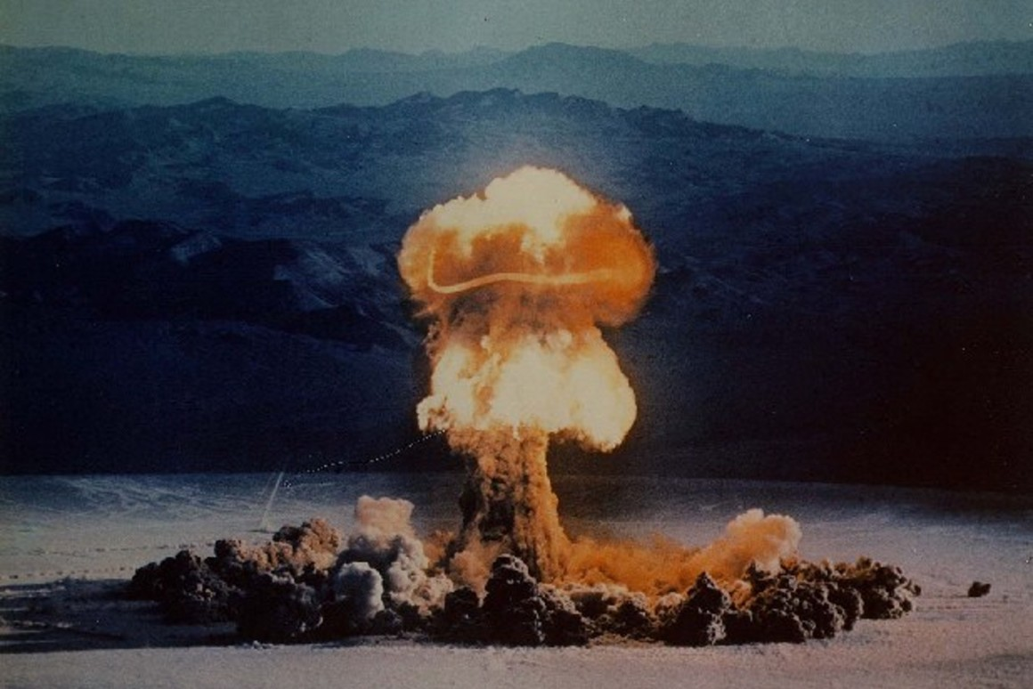
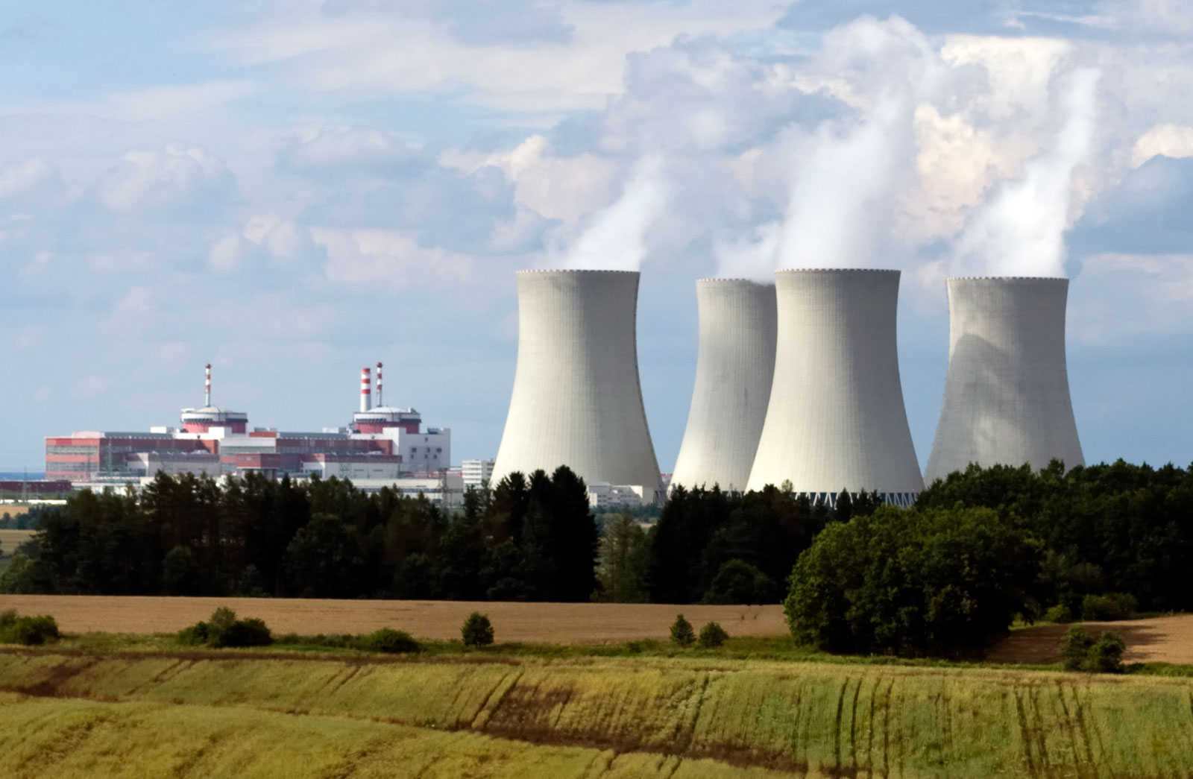
Concept Development
Importance of Uranium Fission
An uncontrolled chain reaction results in a nuclear explosion, like from an atomic bomb.
A controlled chain reaction can be used to produce electricity, in a nuclear reactor.

Slide 36
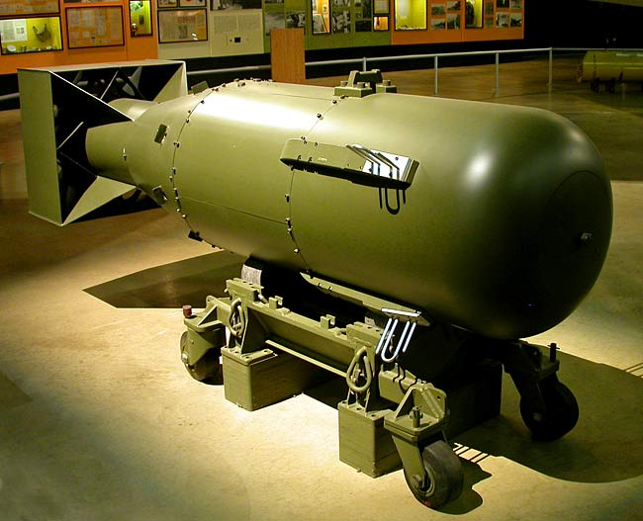
Concept Development
Unit of Measurement
The size of nuclear bombs are measured by comparing their explosive power in terms of kilotons of TNT (a chemical explosive)
Atomic Bombs
In World War II, two nuclear fission bombs were dropped by US solidiers in Japan.
The first bomb was dropped on Hiroshima on August 6, 1945. It weighed 15 kilotons and was nicknamed “Little Boy”.
The second bomb was dropped on Nagasaki three days later. It weighed 22 kilotons and was nicknamed “Fat Man”.

Slide 37
Skill Development/Guided Practice
Collect a worksheet from your teacher and use the information on the next few slides to describe the impacts of an atomic bomb the same size as “Little Boy”, if it was dropped on Perth.
Blast Effects
Fireball: Flames incinerate most buildings, objects, and people.
Radiation: Gamma and other radiation are so intense that 50% or more people will die with in several hours to several weeks.
Air blast: A shock wave which is powerful enough to collapse buildings, rupture eardrums, cause other injuries, and fatalities.
Thermal radiation: Thermal and UV radiation causes 3rd degree burns, which are often painless because they destroy nerves.

Slide 38
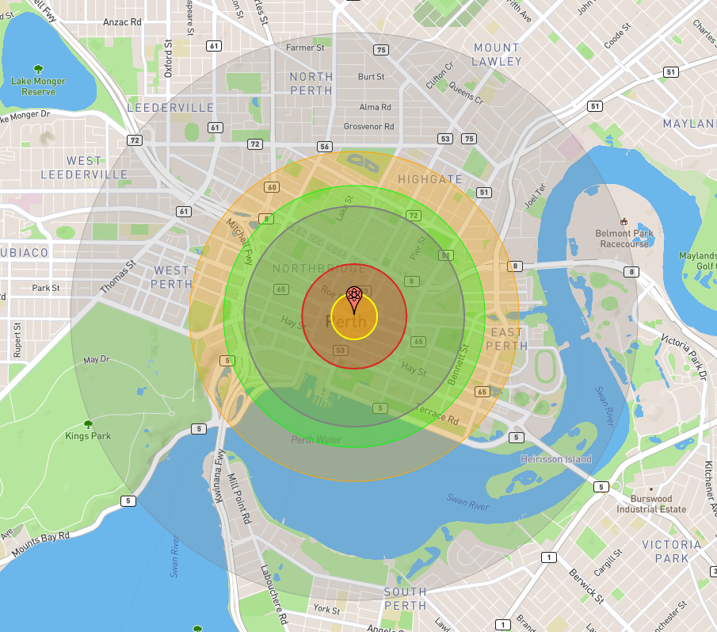
Skill Development/Guided Practice
Draw the impact zones on your map, colour code them and complete the key. (you can use different colours to the map shown)
Yellow: Fireball (0.17 km²)
Red: Air Blast - 20 psi pressure (0.9 km²)
Lilac: Air Blast - 5 psi pressure (4 km²)
Green: Radiation (6 km²)
Orange: Thermal radiation (9 km²)
Grey: Air Blast - 1 psi pressure (26 km²)

Slide 39
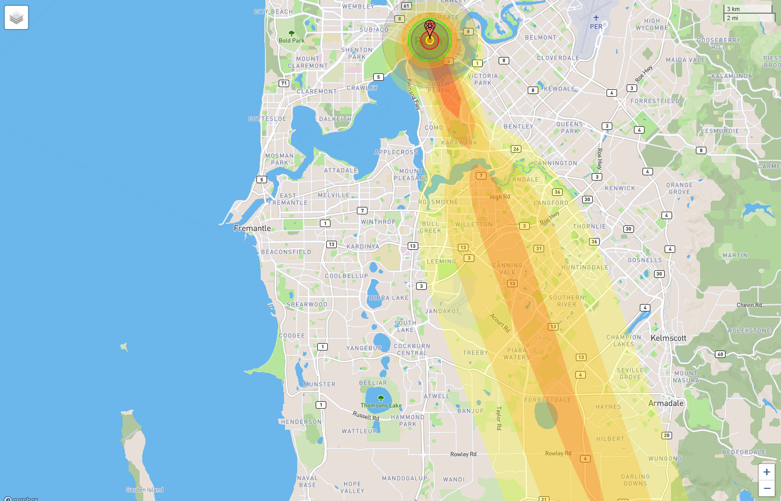
Skill Development/Guided Practice
Write the description of nuclear fallout on the second page of the worksheet.
Nuclear fallout is the residual radioactive material in the air, in the form of dust and ash.
It got its name because it “falls out” of the sky after the explosion and shockwave have passed.
Nuclear fallout is measure in rads, which is the absorbed radiation dose.

Slide 40
Skill Development/Guided Practice
Draw the fallout zones on your map, colour code them and complete the key. (you can use different colours to the map shown)
Red: 1000 rads per hour (5 km)
Dark orange: 100 rads per hour (32 km)
Light orange: 10 rads per hour (72 km)
Yellow: 1 rad per hour (112 km)

